Slide 1
Unit -4
Chapter 9: Virtual Memory
Created By : Vaishali Jain
Asst. Professor
IT department

Slide 2
Virtual Memory
Background
Demand Paging
Copy-on-Write
Page Replacement
Allocation of Frames
Thrashing

Slide 3
Background
Code needs to be in memory to execute, but entire program rarely used
  Error code, unusual routines, large data structures
Entire program code not needed at same time
Advantage of this scheme is that the programs can be larger than physical memory.
Further, virtual memory abstracts main memory into an extremely large, uniform array of storage, separating logical memory as viewed by the user from physical memory
Consider ability to execute partially-loaded program
  Program no longer constrained by limits of physical memory
  Each program takes less memory while running -> more programs run at the same time
    Increased CPU utilization and throughput with no increase in response time or turnaround time
  Less I/O needed to load or swap programs into memory -> each user program runs faster

Slide 4
Background Cont.
Thus, running a program that is not entirely in memory would benefits both the System & the User
Virtual memory – separation of user logical memory from physical memory
  Only part of the program needs to be in memory for execution
  Logical address space can therefore be much larger than physical address space
  Allows address spaces to be shared by several processes
  Allows for more efficient process creation
  More programs running concurrently
  Less I/O needed to load or swap processes
Virtual address space – logical view of how process is stored in memory
  Usually start at address 0, contiguous addresses until end of space
  Meanwhile, physical memory organized in page frames
  MMU must map logical to physical
Virtual memory can be implemented via:
  Demand paging
  Demand segmentation

Slide 5
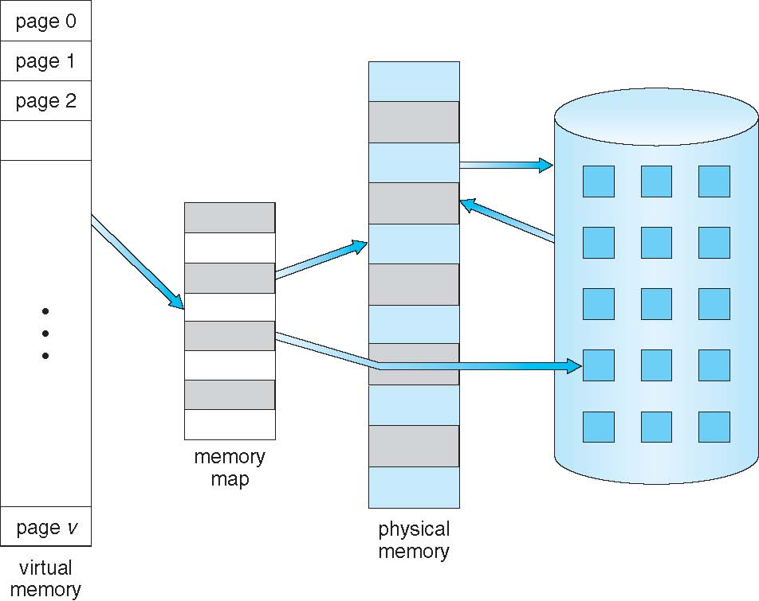
Virtual Memory That is
Larger Than Physical Memory

Slide 6
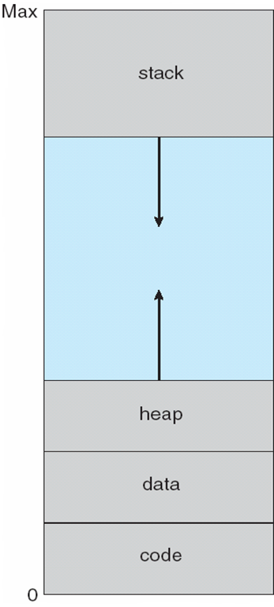
Virtual-address Space
Usually design logical address space for stack to start at Max logical address and grow “down” while heap grows “up” for dynamic allocation.
  Maximizes address space use
  Unused address space between the two is hole
  Virtual address space that include holes are known as Sparse address space

Slide 7
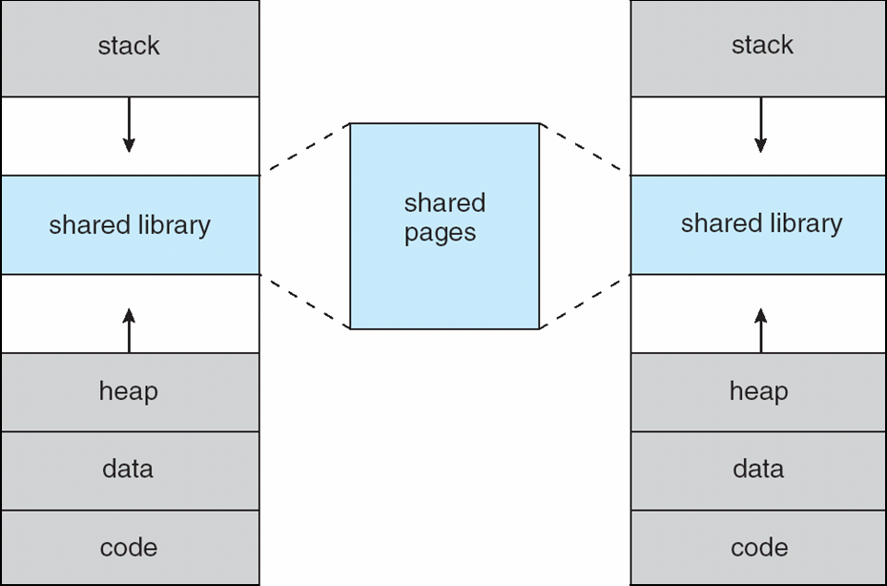
Shared Library Using Virtual Memory
Virtual memory allows file & memory to be shared by two or more processes through page sharing
This leads to the following benefits:
Enables sparse address spaces with holes left for growth, dynamically linked libraries, etc
System libraries shared via mapping into virtual address space
Shared memory by mapping pages read-write into virtual address space
Pages can be shared during fork(), speeding process creation

Slide 8
Cache Memory Organization
A small amount of fast memory that sits between normal main memory and CPU
May be located on CPU chip or module
Intended to allow access speed approaching register speed
When processor attempts to read a word from memory, cache is checked first.
If data sought is not present in cache, a block of memory of fixed size is read into the cache
Locality of reference makes it likely that other words in the same block will be accessed soon
Cache Operation:
CPU requests contents of memory location
Check cache for this data
If present, get from cache (fast)
If not present, read required block from main memory to cache
Then deliver from cache to CPU
Cache includes tags to identify which block of main memory is in each cache slot

Slide 9
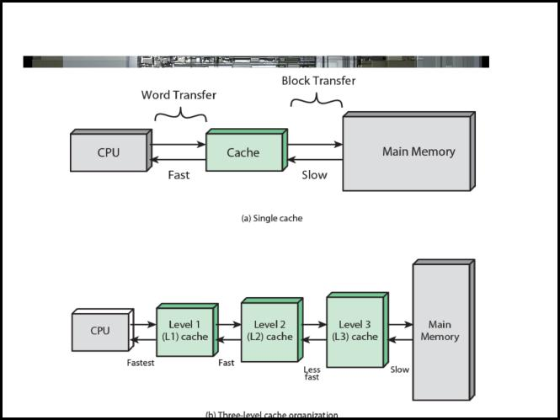
Cache & Main Memory

Slide 10
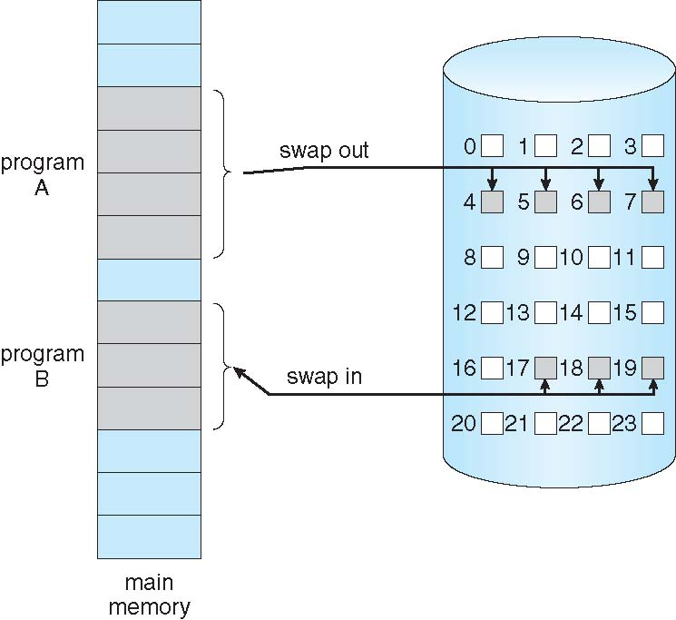
Demand Paging
Could bring entire process into memory at load time
Or bring a page into memory only when it is needed
  Less I/O needed, no unnecessary I/O
  Less memory needed
  Faster response
  More users
Similar to paging system with swapping (diagram on right)
Page is needed ⇒ reference to it
  invalid reference ⇒ abort
  not-in-memory ⇒ bring to memory
Lazy swapper – never swaps a page into memory unless page will be needed
  Swapper that deals with pages is a pager

Slide 11
Basic Concepts
With swapping, pager guesses which pages will be used before swapping out again
Instead of swapping whole process, pager brings in only those pages into memory
How to determine that set of pages?
  Need new MMU functionality to implement demand paging
If pages needed are already memory resident
  No difference from non demand-paging
If page needed and not memory resident
  Need to detect and load the page into memory from storage
    Without changing program behavior
    Without programmer needing to change code

Slide 12
Valid-Invalid Bit
With each page table entry a valid–invalid bit is associated
(v ⇒ in-memory – memory resident, i ⇒ not-in-memory)
Initially valid–invalid bit is set to i on all entries
Example of a page table snapshot:
During MMU address translation, if valid–invalid bit in page table entry
is i ⇒ page fault
Frame #
valid-invalid bit
v
v
v
v
i
….
i
i
page table

Slide 13
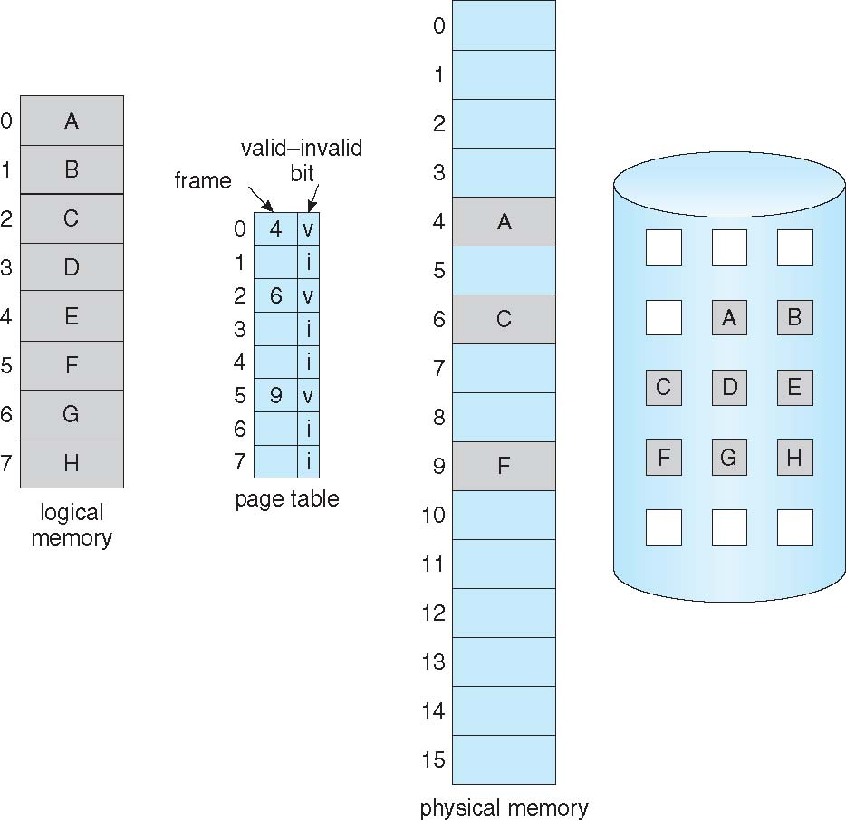
Page Table When Some Pages Are Not in Main Memory

Slide 14
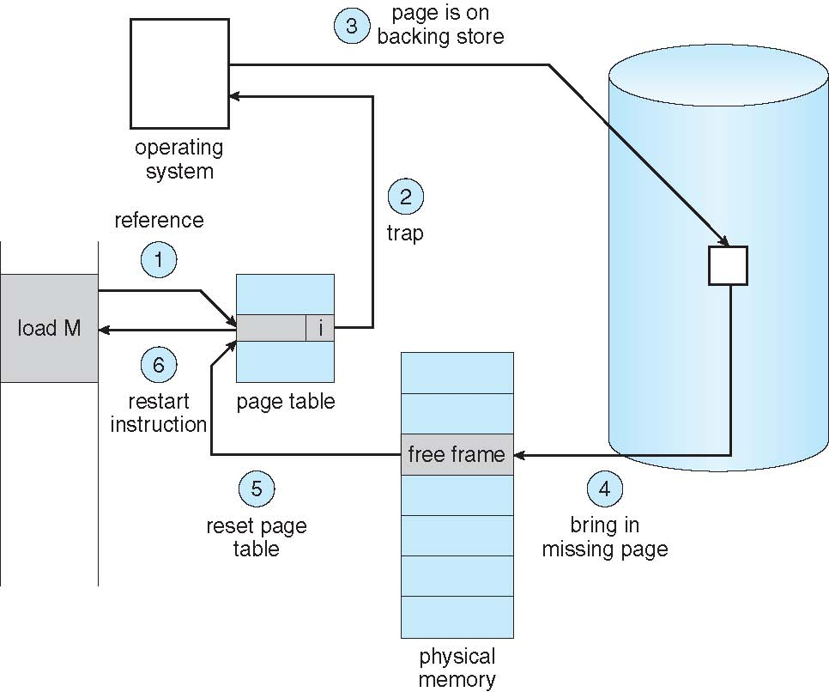
Page Fault
If there is a reference to a page, first reference to that page will trap to operating system:
page fault
Operating system looks at another table to decide:
  Invalid reference ⇒ abort
  Just not in memory
If the reference was invalid , determine the process otherwise page it now.
Find free frame
Swap page into frame via scheduled disk operation
Reset tables to indicate page now in memory
Set validation bit = v
Restart the instruction that caused the page fault

Slide 15
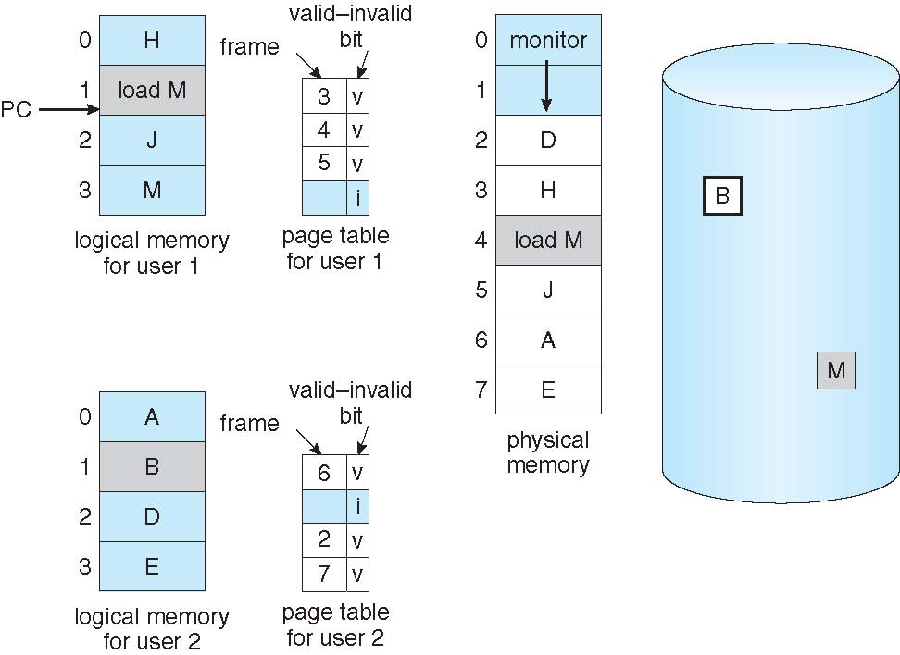
Page Replacement
Prevent over-allocation of memory by modifying page-fault service routine to include page replacement.
When a page fault occur, the OS determines the desired page on the disk but then find there are no free frames in free frame list.
Need For Page Replacement

Slide 16
Cont..
OS has several options for this:
    Terminate the user process.
    Demand paging but paging should be logically transparent to users. So this is not the best choice.
    Use swapping with the help of Disk.
    Page Replacement

Slide 17
Basic Page Replacement Steps
Find the location of the desired page on disk
Find a free frame:
- If there is a free frame, use it
- If there is no free frame, use a page replacement algorithm to select a victim frame
- Write victim frame to disk ; change the page & frame tables accordingly.
Bring the desired page into the (newly) free frame; update the page and frame tables
Continue the process by restarting the instruction that caused the trap
Note : if no frames are free then 2 page transfers(one out & one in) required for increasing EAT

Slide 18
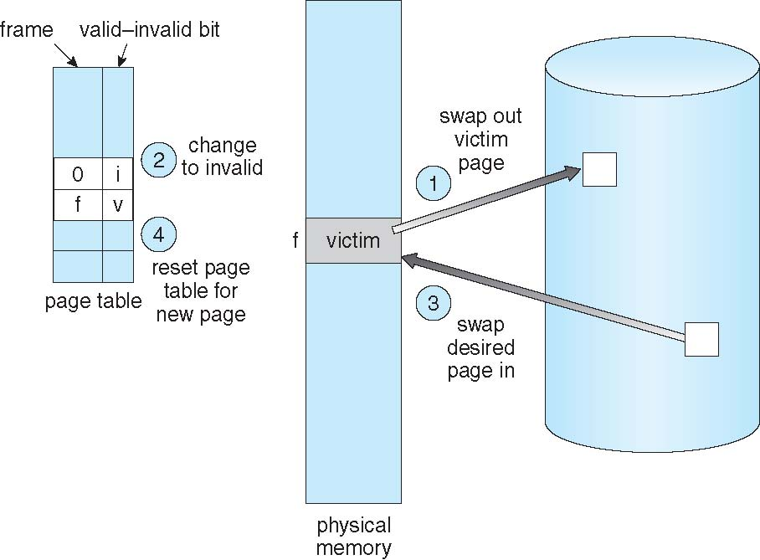
Page Replacement

Slide 19
Page and Frame Replacement Algorithms
We must solve the 2 major problems to implement demand paging
Frame-allocation algorithm determines
  How many frames to give each process
  Which frames to replace
Page-replacement algorithm
  Want lowest page-fault rate on both first access and re-access
We evaluate an algorithm by running it on a particular string of memory references (reference string) and computing the number of page faults on that string
  String is just page numbers, not full addresses
  Repeated access to the same page does not cause a page fault
  Results depend on number of frames available
In all our examples, the reference string of referenced page numbers is
7,0,1,2,0,3,0,4,2,3,0,3,0,3,2,1,2,0,1,7,0,1

Slide 20
Page Replacement Algorithm
FIFO Page Replacement
Optimal Page Replacement
LRU Page Replacement
Counting-Based Page Replacement

Slide 21
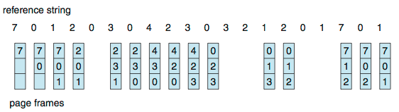
First-In-First-Out (FIFO) Page Replacement
Reference string: 7,0,1,2,0,3,0,4,2,3,0,3,0,3,2,1,2,0,1,7,0,1
3 frames (3 pages can be in memory at a time per process); insert page at the tail of queue
Can vary by reference string: consider 1,2,3,4,1,2,5,1,2,3,4,5
  Adding more frames can cause more page faults!
    Belady’s Anomaly
How to track ages of pages?
  Just use a FIFO queue
15 page faults

Slide 22
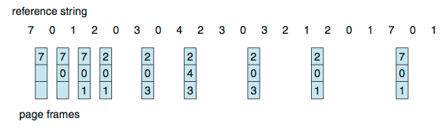
Optimal Page Replacement
Replace page that will not be used for longest period of time
  9 page faults is optimal for the example
Much better than FIFO.
Difficult to implement coz need future knowledge of reference
Used for measuring how well your algorithm performs

Slide 23
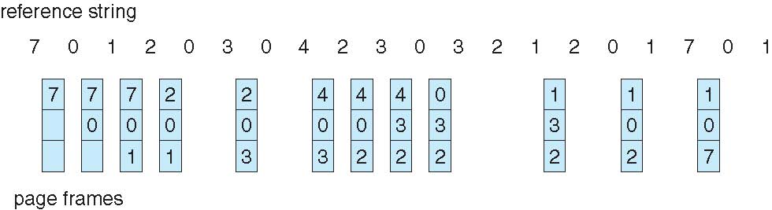
Least Recently Used (LRU) Algorithm
Use past knowledge rather than future
Replace page that has not been(least recently used) used in the most amount of time
Associate time of last use with each page
12 faults – better than FIFO but worse than OPT
Generally good algorithm and frequently used

Slide 24
LRU Algorithm (Cont.)
Counter implementation
  Every page entry has a counter; every time page is referenced through this entry, copy the clock into the counter
  When a page needs to be changed, look at the counters to find smallest value
    Search through table needed
Stack implementation
  Keep a stack of page numbers in a double link form:
  Page referenced:
    move it to the top
  But each update more expensive
  No search for replacement
LRU and OPT are cases of stack algorithms that don’t have Belady’s Anomaly

Slide 25
LRU Approximation Algorithms
LRU needs special hardware and still slow
Reference bit
  With each page associate a bit, initially = 0
  When page is referenced bit set to 1
  Replace any with reference bit = 0 (if one exists)
    We do not know the order, however
Second-chance algorithm
  It is a FIFO replacement algorithm
  When page has been selected reference bit inspected
  Clock replacement
  If page to be replaced has
    Reference bit = 0 -> replace it
    reference bit = 1 then:
      set reference bit 0, leave page in memory
      replace next page, subject to same rules

Slide 26
Second-Chance (clock) Page-Replacement Algorithm

Slide 27
LRU Approximation Algorithms Cont…
Enhanced Second-Chance Algorithm
Improve algorithm by using reference bit and modify bit (if available) in concert
Take ordered pair (reference, modify)
  (0, 0) neither recently used not modified – best page to replace
  (0, 1) not recently used but modified – not quite as good, must write out before replacement
  (1, 0) recently used but clean – probably will be used again soon
  (1, 1) recently used and modified – probably will be used again soon and need to write out before replacement

Slide 28
Counting Algorithms
It keeps a counter of the number of references that have been made to each page
  Not common
Lease Frequently Used (LFU) Algorithm:
  replaces page with smallest count
  An actively used page should have large reference count
  Problem :
    If a page used heavily during the initial phase of a process but then is never used again.
    Solution is to shift the counts by 1 bit at regular intervals.
Most Frequently Used (MFU) Algorithm: based on the argument that the page with the smallest count was probably just brought in and has yet to be used

Slide 29
LFU example (do it yourself)
reference string
7 | 0 | 1 | 2 | 0 | 3 | 0 | 4 | 2 | 3 | 0 | 3 | 2 | 1 | 2 | 0 | 1 | 7 | 0 | 1
page frame
 |  |  |  |  |  |  |  |  |  |  |  |  |  |  | Page fault=
Count :
7= 0= 1= 2= 3= 4=

Slide 30
Allocation of Frames
How do we allocate fixed amount of frames to various processes.
Allocate each process minimum number of frames from free frame list
Maximum of course is total frames in the system
Two major allocation schemes
  fixed allocation
  priority allocation

Slide 31
Fixed Allocation
Equal allocation –
  split m frames among n processes with equal share of m/n frames .
  For example : there are 93 frames and 5 processes ; each process will get 18 frames ; remaining 3 leftover frames can be used as a free-frame buffer pool
Proportional allocation – Allocate according to the size of process
  Dynamic as degree of multiprogramming, process sizes change

Slide 32
Priority Allocation
Use a proportional allocation scheme using priorities rather than size
If process P_{i} generates a page fault,
  select for replacement one of its frames
  select for replacement a frame from a process with lower priority number

Slide 33
Global vs. Local Allocation
Global replacement – process selects a replacement frame from the set of all frames; one process can take a frame from another
  But then process execution time can vary greatly
  But greater throughput so more common
Local replacement – each process selects from only its own set of allocated frames
  More consistent per-process performance
  But possibly underutilized memory

Slide 34
Non-Uniform Memory Access
So far all memory accessed equally
Many systems are NUMA – speed of access to memory varies
  It consider system boards containing CPUs and memory, interconnected over a system bus

Slide 35
Thrashing
If a process does not have “enough” pages, the page-fault rate is very high
  Page fault to get page
  Replace existing frame
  But quickly need replaced frame back
  This leads to:
    Low CPU utilization
    Operating system thinking that it needs to increase the degree of multiprogramming
    Another process added to the system
Thrashing ≡ Hence the high paging activity which result in page fault again and again because the process is busy swapping pages in and out

Slide 36
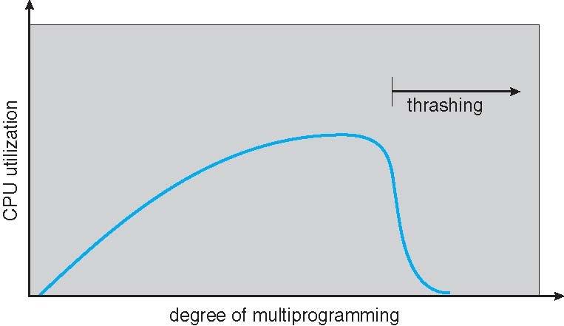
Thrashing (Cont.)

Slide 37
Demand Paging and Thrashing
Why does demand paging work?
Locality model
  Process migrates from one locality to another
  Localities may overlap
Why does thrashing occur?
Σ size of locality > total memory size
  Limit effects by using local or priority page replacement

Slide 38
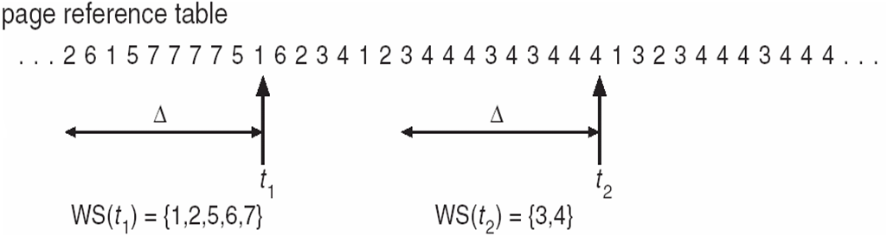
Working-Set Model based on assumption of locality
Δ ≡ working-set window ≡ a fixed number of page references
Example: 10,000 instructions
m= total number of frames
WSS_{i} (working set of Process P_{i}) =
total number of pages referenced in the most recent Δ (varies in time)
  if Δ too small will not encompass entire locality
  if Δ too large will encompass several localities
  if Δ = ∞ ⇒ will encompass entire program
D = Σ WSS_{i} ≡ total demand frames
  Approximation of locality
if D > m ⇒ Thrashing
Policy if D > m, then suspend or swap out one of the processes

Slide 39
Page-Fault Frequency
More direct approach than WSS
Establish “acceptable” page-fault frequency (PFF) rate and use local replacement policy
  If actual rate too low, process loses frame
  If actual rate too high, process gains frame

Slide 40


